Slide 1
Timeline Data Project 2026
Devin Tran

Slide 2
Analysis Questions
01.
How do geographic movement patterns change throughout different times of day?
02.
How does geographic footprint change throughout the course of a week?
03.
What is the class average commute time from home to the BYU campus?

Slide 3





Q1 Geographic Patterns by Time of Day
First Movement
9:24 AM
Class Avg Wake
Last Movement
10:18 AM
Class Avg Sleep
Top Exploratory Destinations
Morning (6am-12pm)
BYU, Spencer W. Kimball Tower, HBLL
Afternoon (12pm-6pm)
BYU, Harold B. Lee Library (HBLL), WSC
Evening (6pm-12am)
BYU, Walmart Market, Parkway Village
Night (12am-6am)
Provo Rec Center, Cape Canaveral Space Force
Overall Mobility vs. BYU Presence
Morning
Campus: 1206 visits — Total: 2045 visits
Afternoon
Campus: 867 visits — Total: 2448 visits
Evening
Campus: 232 visits — Total: 1648 visits

Slide 4
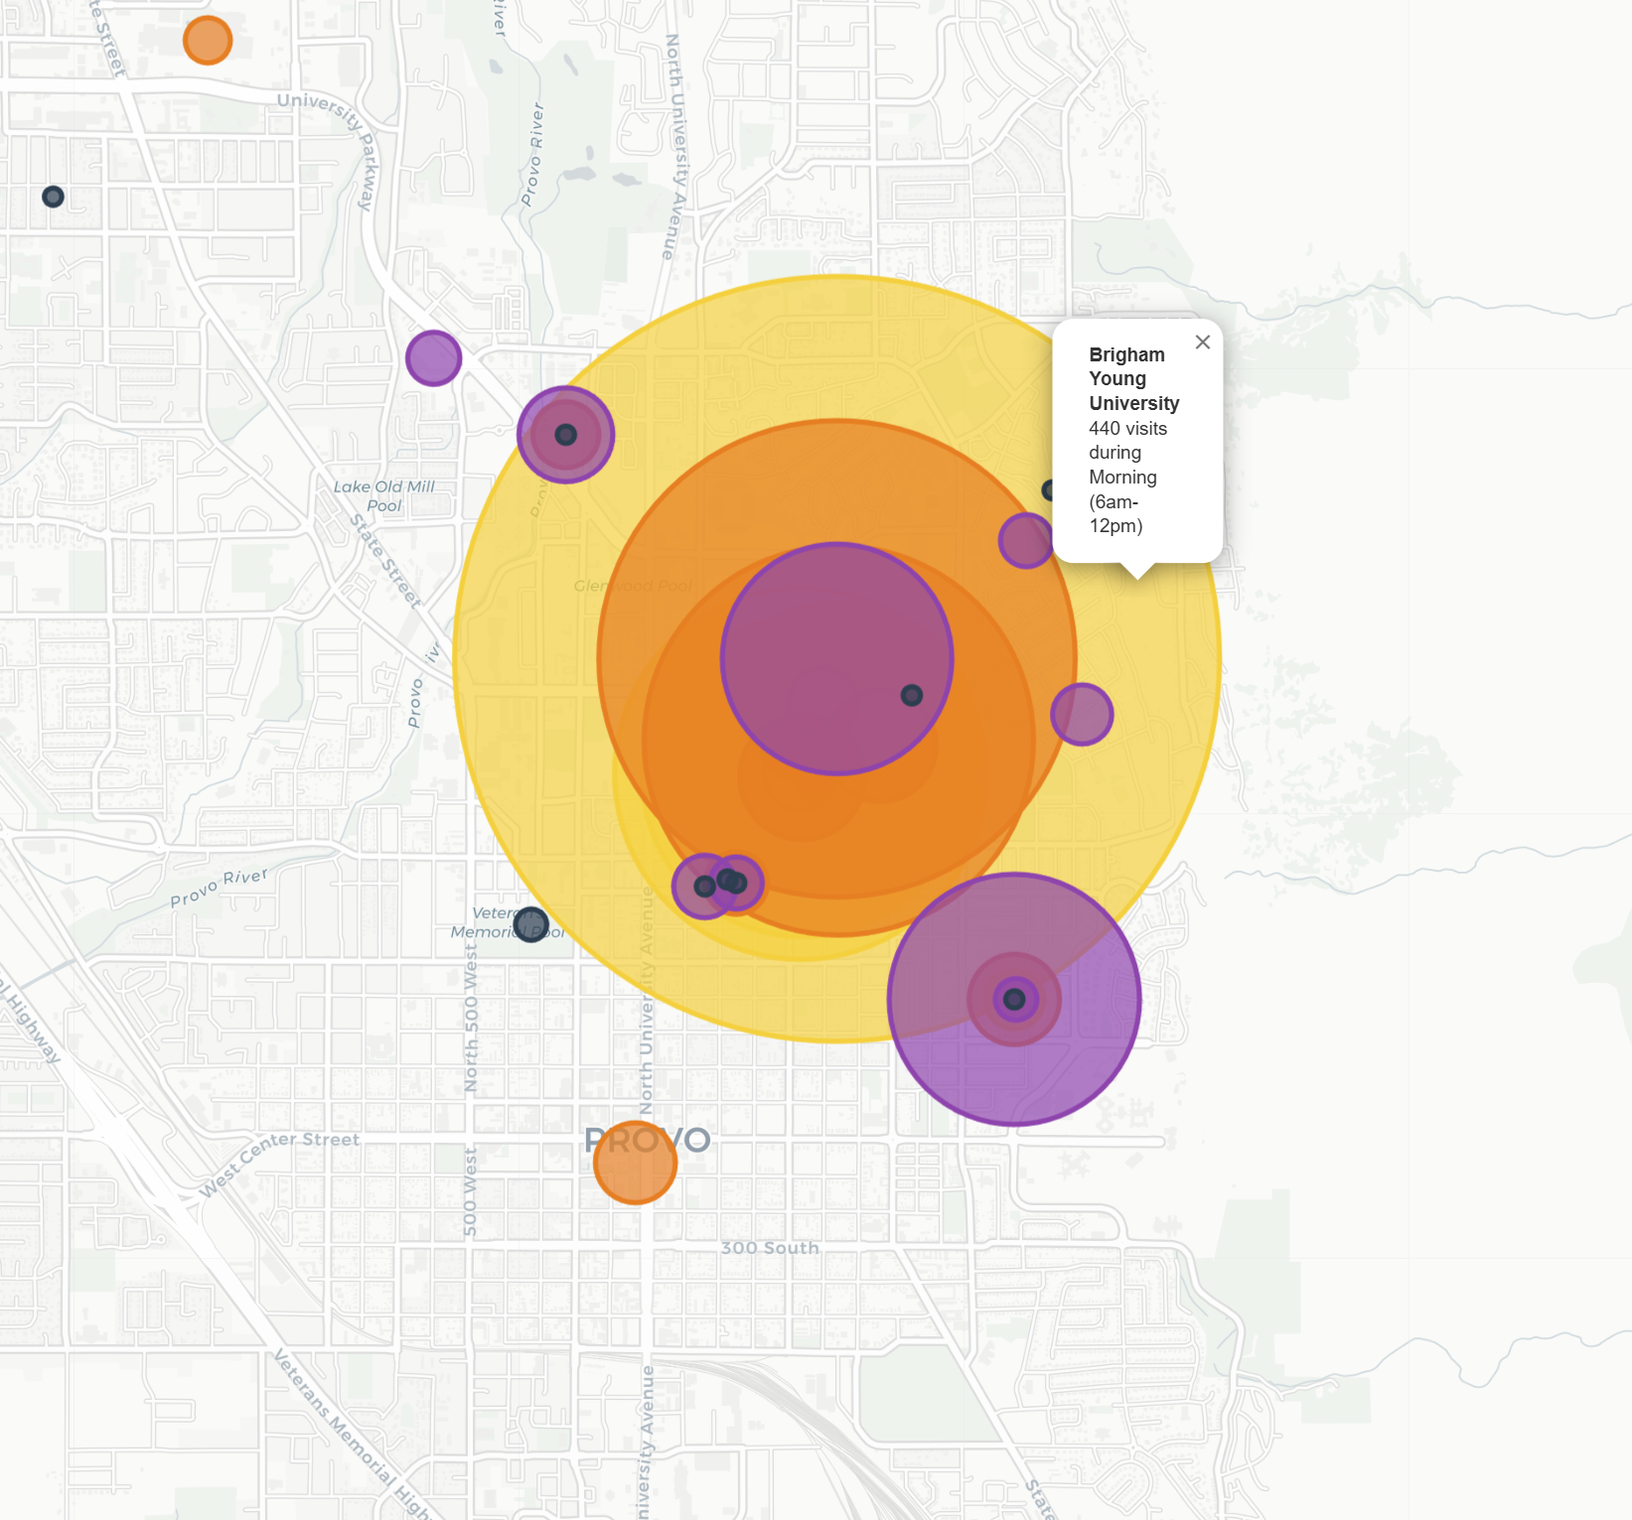
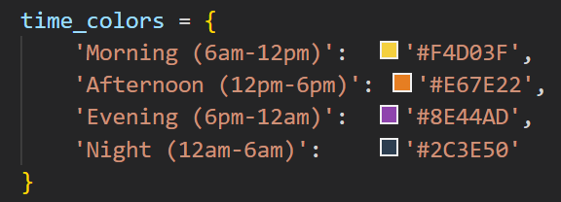
Q1 Geographic Patterns by Time of Day

Slide 5
Q2 Geographic Footprint Throughout the Week
Avg Unique Places
Weekday
64.6
Avg Unique Places
Weekend
37.9
Visits by Day of Week
Mon
318
Tue
397
Wed
290
Top Daily Destinations
Mon: Hwy 198 / 750 N, 380 N 1020 E St
Tue: Provo City Center Temple, Payson Court
Wed: Hwy 198, Hilton SF Union Square
Thu: Payson Court, STRATFORD PARK
Fri: Maverik, Chick-fil-A, Provo Rec Center
Sat: Walmart Supercenter, Parkway Village
Sun: LDS Church (68 visits), 2861 N 220 E St
Thu
348
Fri/Sat+
564
Weekend Profile (Sat-Sun)
The weekend shows a significant shift toward retail and religious activities. Saturday is the busiest day of the week with 564 total visits, while Sunday is dominated by LDS Church visits (nearly 25% of all weekend activity).
Peak Weekend Spots:
• Walmart Neighborhood Market
• University Place
• Provo City Center Temple

Slide 6
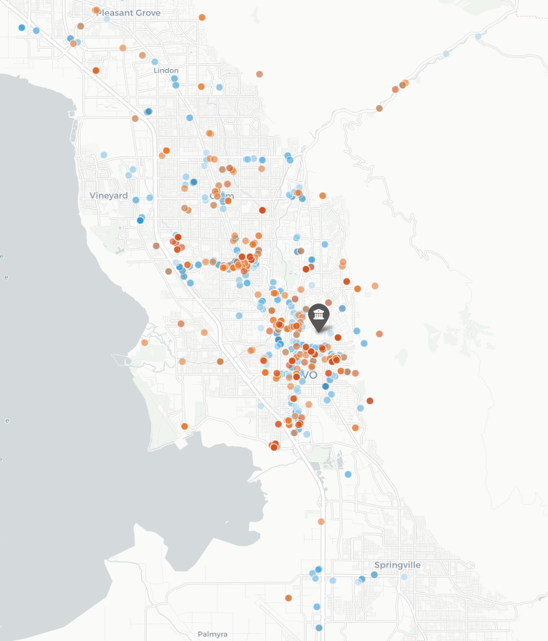
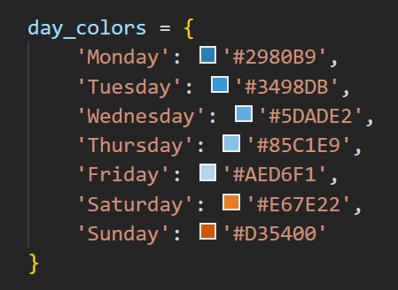
Q2 Geographic Footprint Throughout the Week

Slide 7
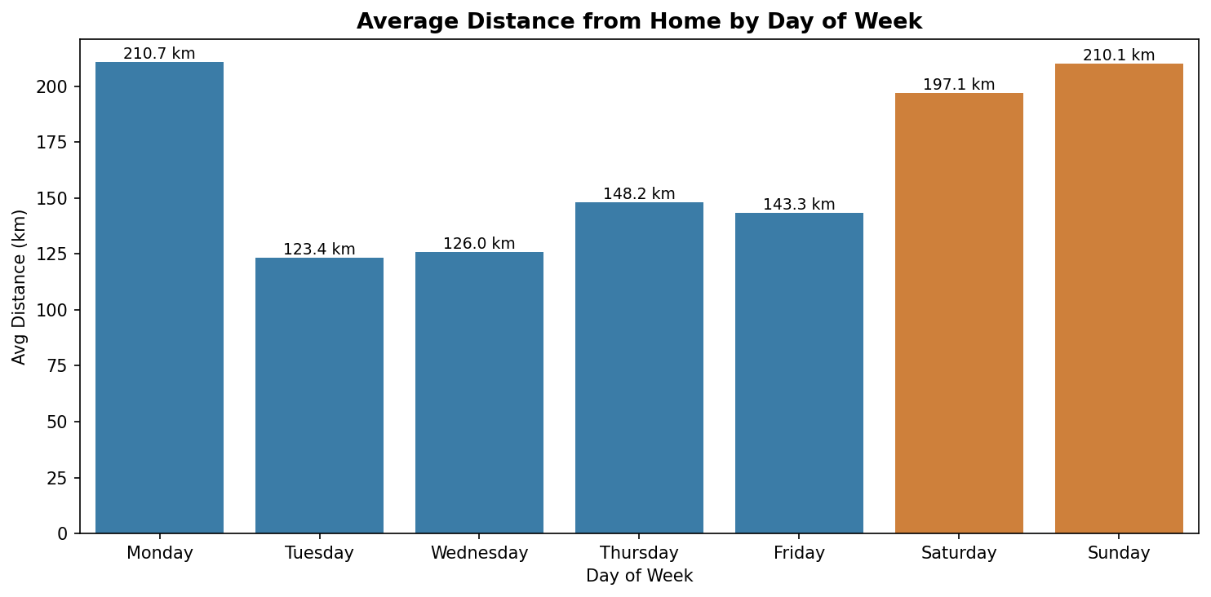
Q2 Geographic Footprint Throughout the Week

Slide 8
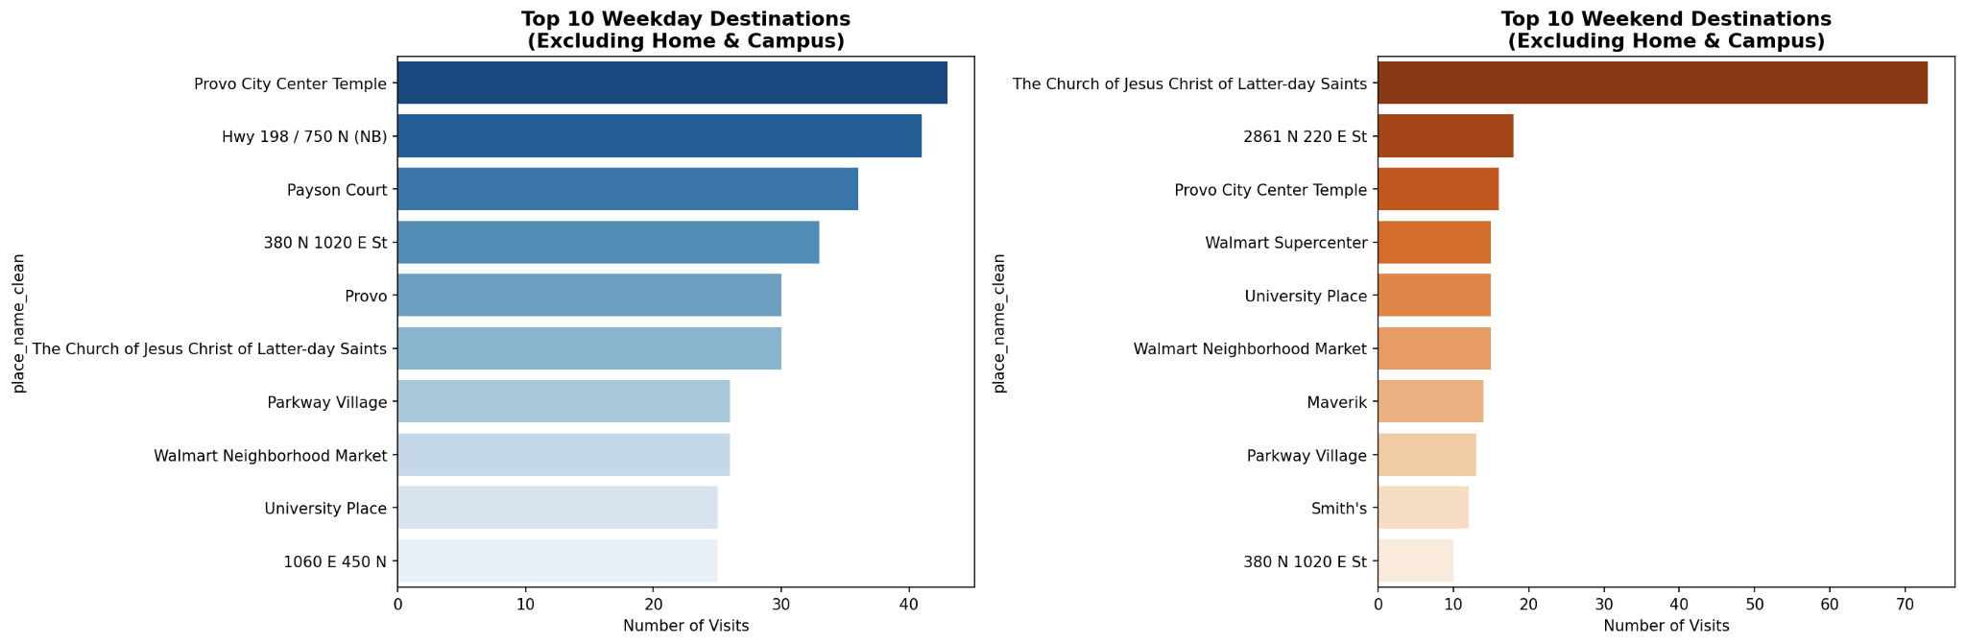
Q2 Geographic Footprint Throughout the Week

Slide 9
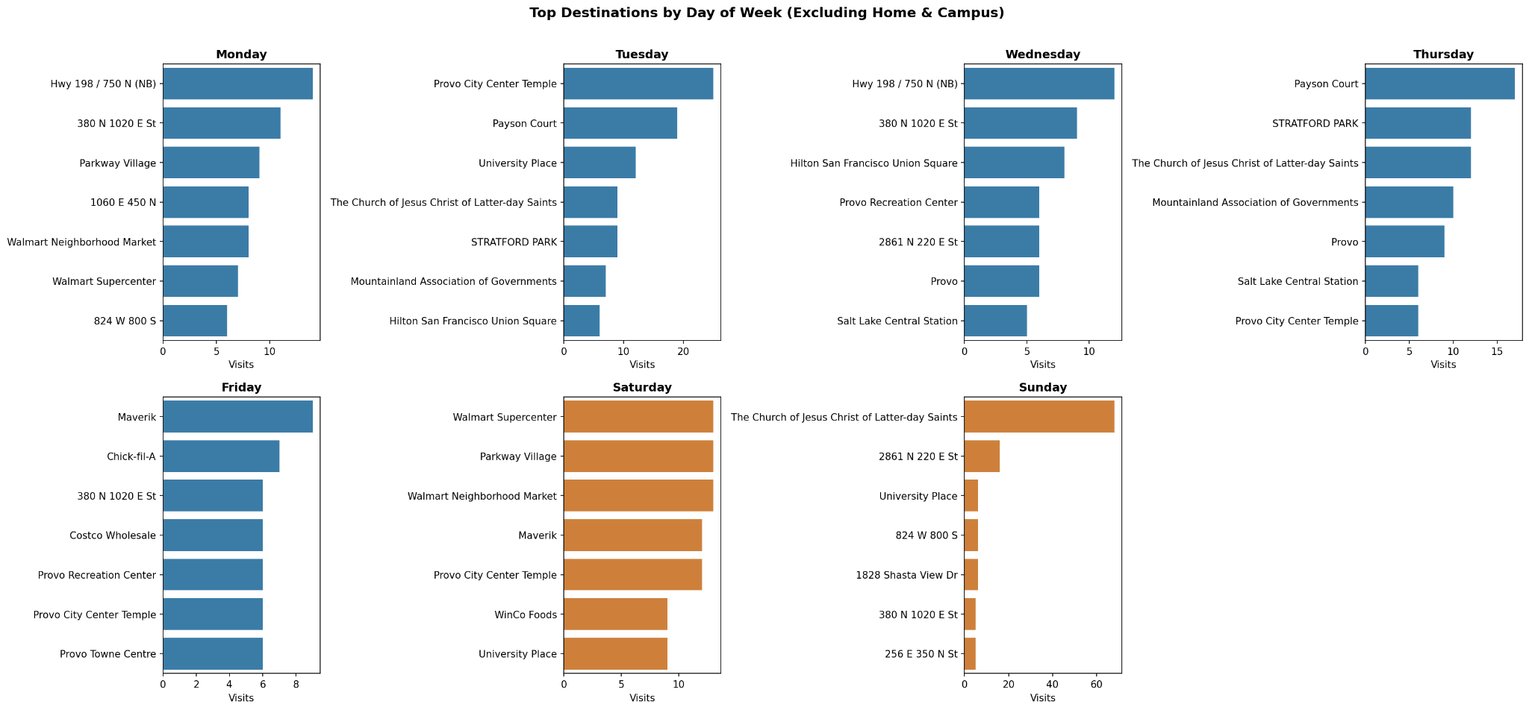
Q2 Geographic Footprint Throughout the Week

Slide 10
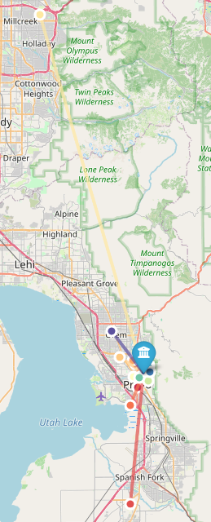
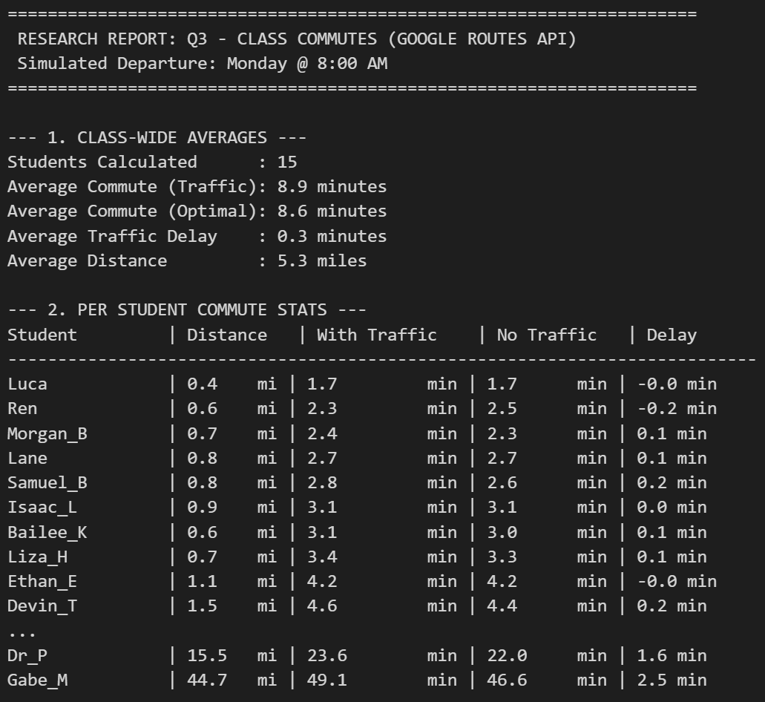
Q3 Class Commutes Analysis
Average Commute
Traffic Adjusted
8.9 mins
Average Distance
Total Route
5.3 miles

Slide 11
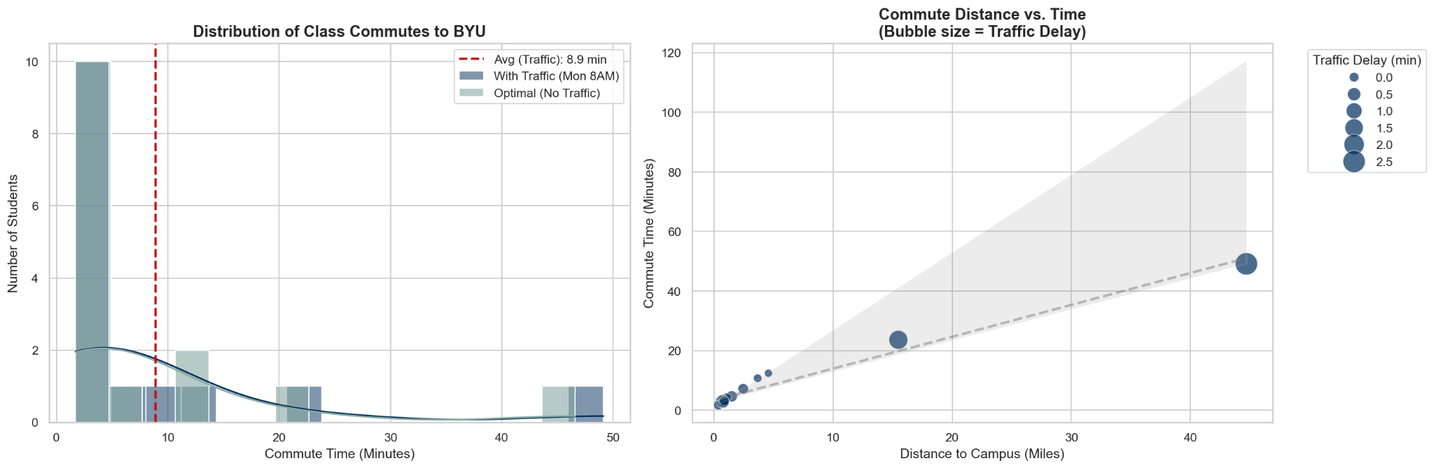
Q3 Class Commutes Analysis

Slide 12
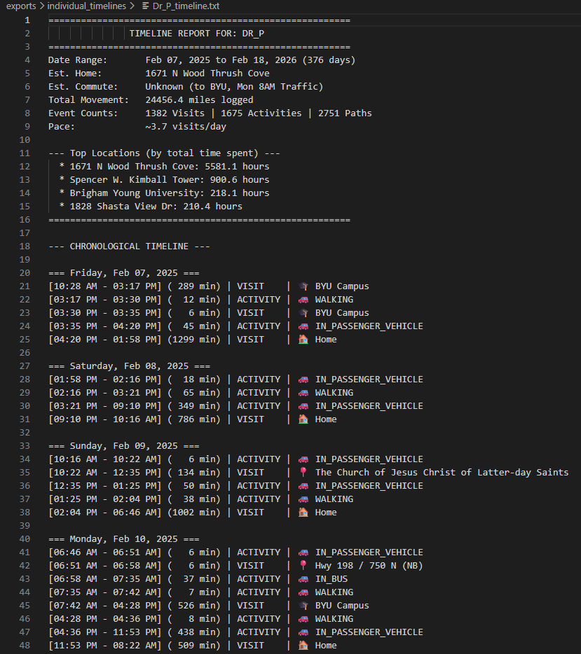
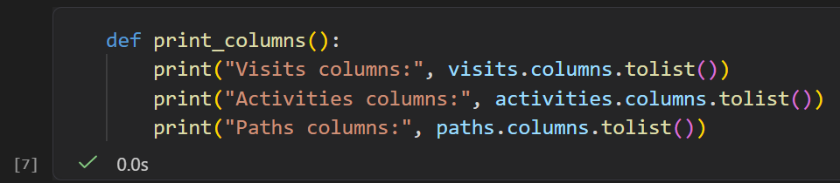

Individual Timelines
Visits columns: ['person', 'startTime', 'endTime', 'placeId', 'semanticType', 'probability', 'geometry', 'start_hour', 'time_of_day', 'day_name', 'day_number', 'duration', 'time_since_epoch', 'minutes_since_epoch', 'global_sequence_id', 'on_campus', 'place_name', 'place_address', 'place_name_clean', 'end_hour']
Activities columns: ['person', 'startTime', 'endTime', 'activityType', 'distanceMeters', 'probability', 'startPoint', 'endPoint', 'geometry', 'start_hour', 'time_of_day', 'day_name', 'day_number', 'duration', 'time_since_epoch', 'minutes_since_epoch', 'global_sequence_id', 'on_campus']
Paths columns: ['person', 'startTime', 'endTime', 'pointCount', 'geometry', 'start_hour', 'time_of_day', 'day_name', 'day_number', 'duration', 'time_since_epoch', 'minutes_since_epoch', 'global_sequence_id', 'on_campus', 'distance_miles']

Slide 13
Thank you!

